Slide 1

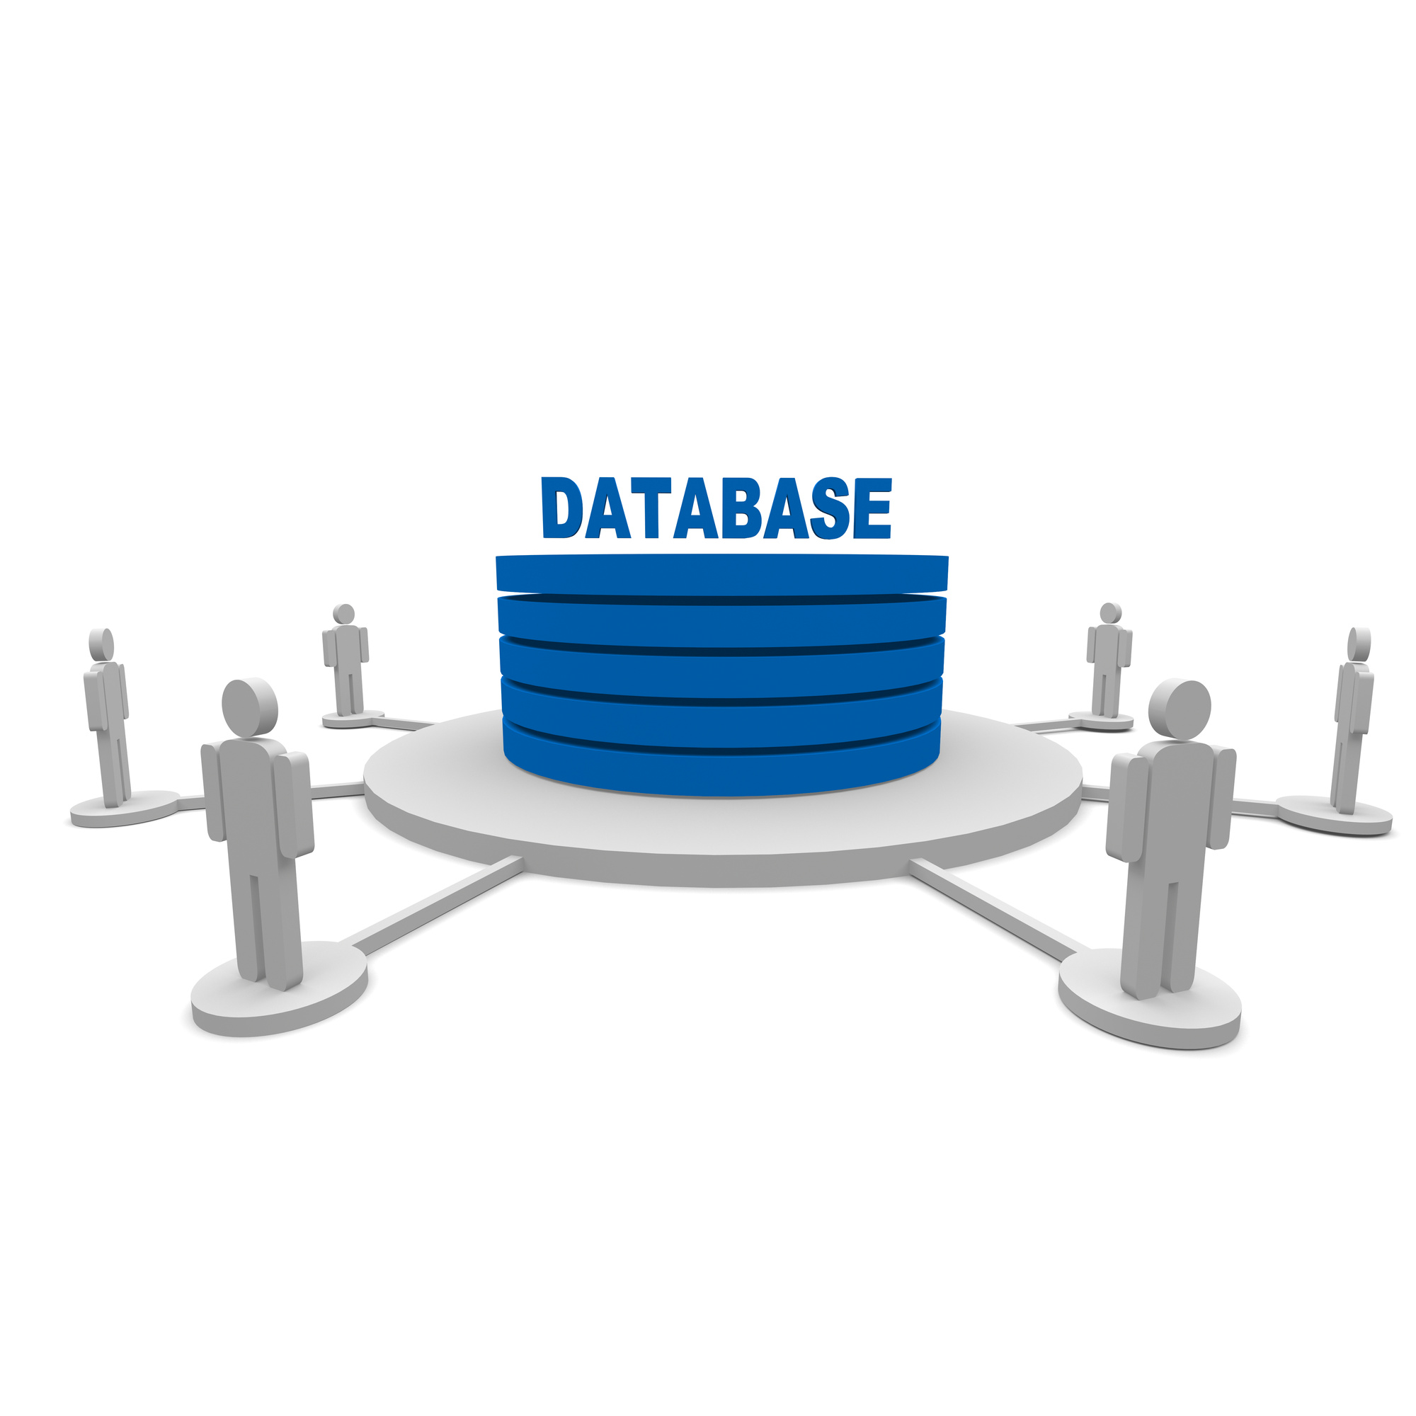







Kuick Commerce Database Project Presentation
Jarrar Amjad, Prayas Gautam, Deekshitha Kalluri

Slide 2



Introduction
Overview of Quick Commerce
Objective:
Design and develop a Quick Commerce system with a responsive website frontend and a PostgreSQL backend hosted on Supabase.
About Quick Commerce:
Q-Commerce enables ultra-fast delivery of essentials like groceries and snacks—typically within minutes of ordering.
What We Built:
SQL functions & triggers for real-time automation
Frontend connected via Supabase APIs
Features: user login, product browsing, cart, order placement, feedback
Potential Users:
Customers – browse, order, and track essentials

Slide 3

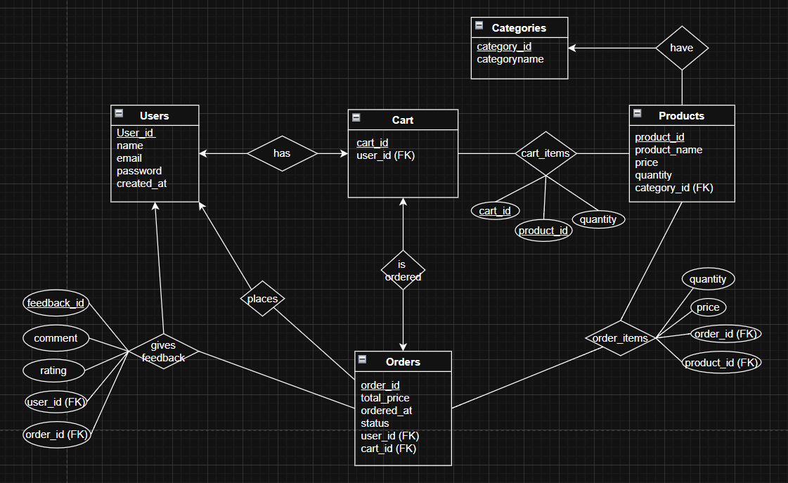
ER-Diagram

Slide 4
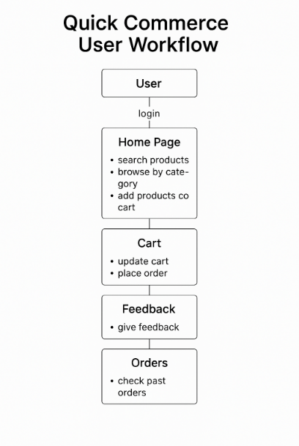
This diagram shows the step-by-step journey of a user on our Quick Commerce website:
User The process starts with a user visiting the website.
Login The user logs in through Supabase Auth. If it’s a new user, their data is also stored in the users table.
Home Page Once logged in, the user lands on the home page where they can:
🔍 Search products by name
🗂️ Browse by category (like groceries or snacks)
➕ Add products to cart for purchase
Cart The user then navigates to the cart page where they can:
🛒 Update their cart (change quantities or remove items)
✅ Place an order, which triggers backend functions and stock updates
Feedback After order completion, the user can:
⭐ Give feedback by rating and commenting on their order experience
Orders Finally, users can go to the Orders page to:
📦 Check past orders — this includes items, status, and total cost

Slide 5

Page / Feature | Functionality | DBMS Logic / SQL Used
Login | User login via Supabase Auth | auth.users, handle_new_user trigger
Home Page | Search products, view by category, add to cart | ILIKE for search, FK on category_id, cart_items table
Cart | View/edit cart, place order | process_order, inserts into orders, hasorderitems. Reduces stock after orders placed using reduce_stock trigger function
Orders | View previous orders | Uses get_user_orders(user_id) function
Feedback | Rate orders and give comments | Inserts into givesfeedback, FK to users & orders
Transaction/Stock Safety | Prevent over-ordering, rollback on error | Inside process_order, RAISE EXCEPTION, rollback
Indexes | Planned for performance optimization | Will implement B-tree indexes on key fields (e.g., user_id, product_id, order_id) in future
Functionality of the Database
The Quick Commerce Database is designed to enhance user experience through its intuitive interface and robust features. It manages user transactions, order tracking, and inventory updates in real-time using relational integrity, SQL functions, and automated triggers.

Slide 6



Live Demo

Slide 7
Future Scope
Admin Dashboard:
Add role-based access for administrators to manage users, products, and feedback.
Inventory Management Module:
Enable real-time stock alerts, restocking workflows, and low-stock analytics.
Delivery Agent Interface:
Assign orders to delivery agents and allow status tracking by users.
Payment Integration:
Connect with payment gateways (e.g., Razorpay, Stripe) for complete checkout experience.
Search & Recommendation Engine:
Improve product discovery using AI-based search and personalized suggestions.
Performance Optimization:
Add indexes and query tuning for scalability with larger datasets.

Slide 8




Q & A

